Slide 1
ENVIRONMENTAL
POLLUTION
Government engineering College Bhuj(015)

Slide 2
PREPARED BY :-
MODHVADIYA KARAN N. 130150106061
MODHVADIYA JAYMAL M. 130150106062
JOSHI SANDIPKUMAR V
130150106040
GUIDE BY: PROF. Y.M. GAJERA

Slide 3
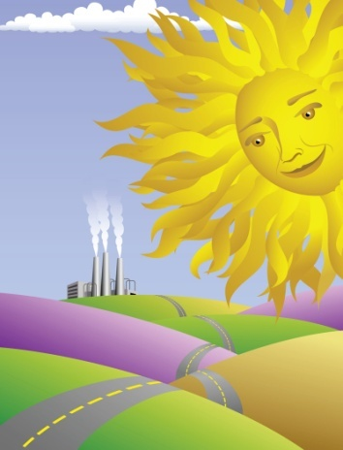
DEFINITION OF POLLUTION
When Harmful Substances Contaminate the Environment it is Called Pollution.
Pollution refers to the very bad condition of environment in terms of quantity and quality .

Slide 4
Types of Pollution
There are Four types of Pollution
Air Pollution
Water Pollution
Noise Pollution
Land Pollution

Slide 5
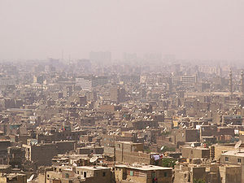
What is Atmosphere
Atmosphere is the life blanket of Earth.
It is essential that we know more about the atmosphere and the ways in which it is polluted.

Slide 6
Causes of Air Pollution
Major sources of Air Pollution
- Industries
-Automobiles and Domestic fuels
-Undesirable gases, such as sulphur
dioxide and carbon monoxide

Slide 7

Effects of Air Pollution
Air Pollution affects...
Human health
Animals
Plants
The atmosphere as a whole

Slide 8
How to Avoid Air Pollution
Yes, we can avoid pollution As Follows
Use natural gases
Use less Amount of Fuel for Vehicles
Use electric stoves
(bio gas)‏

Slide 9
Definition of Water Pollution
The Contamination of water with
undesirable substances which make it unfit for usage is termed water pollution.

Slide 10
Causes of Water Pollution
About 40% of Deaths worldwide are caused by Water Pollution.
Water Pollution is Caused by organic and inorganic industrial wastes.
Noise also causes anxiety stress reaction and fright.

Slide 11
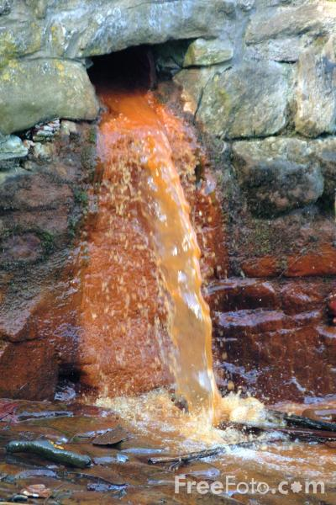
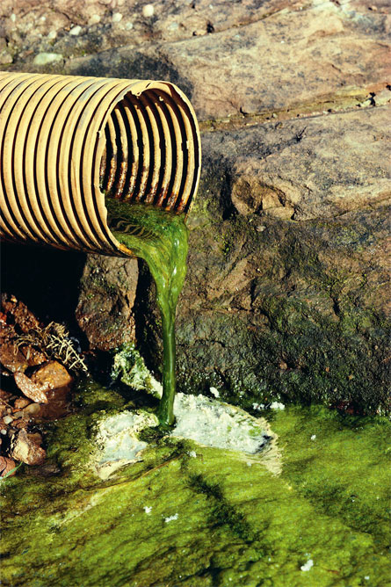
Water Pollution Pictures

Slide 12
Effects of Water Pollution
Diseases like Cholera
Malaria
Typhoid (spread during the rainy season )‏
Aquatic life is destroyed

Slide 13
How to Avoid Water Pollution
Rivers should not be used for washing clothes or bathing animals.
Harvesting of Rainwater to meet water requirements.
Dams & embankments must be created.
The rivers must not be contaminated.

Slide 14
NOISELESS ATMOSPHERE
Noise can be simply defined as unwanted sound.
The sound is pleasant or not depends upon its loudness, duration, rhythm and the mood of the person.
Noise pollution results in irritation and anger.

Slide 15
Causes of Noise Pollution
Traffic Noise
Air craft Noise
Noise from construction and civil engineering works.
Noise from the Industries.
Noise from other sources.

Slide 16
Effects of Noise Pollution
Hearing Loss
High Blood Pressure
Stress
Sleep Disturbance
Color Blindness

Slide 17
How to Avoid Noise Pollution
The Government should ensure that new machines should be noise proof.
Airports must be built away from residential areas.

Slide 18

Prevention of Noise Pollution
Pleasant Home
We need to talk sweetly to others.
Talk Less Work More.
Sound affects our ears so loud noise should be avoided.

Slide 19

Definition of Land Pollution
One fourth of earth’s surface is covered by land.
Land is an earth which is occupied by people for shelter, occupation etc..,

Slide 20
Causes of Land Pollution
We can classify major sources that lead to land following Categories
Mining and quarrying
Sewage waste
Household Garbage
Industrial Waste

Slide 21
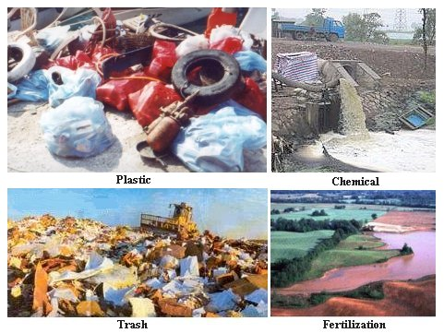
Land pollution pictures

Slide 22
Prevention of Land Pollution
More and more land should be brought under farming
Trees should be planted everywhere.
Waste matter should be disposed immediately
Avoid drilling the Land for more underground water.
Avoid using more fertilizers and Pesticides.

Slide 23

VIDEO

